Slide 1
Using GIS to Quantify Effects of Land Cover Change on Movement Patterns of Tiger Rattlesnakes (Crotalus tigris) in an Urbanizing Environment
Karen Perkins
Mentor: Matt Goode
University of Arizona
School of Natural Resources and the Environment
Arizona Space Grant Symposium
April 17th, 2021

Slide 2
Overview
Rapid development of Tucson
Urban expansion into Sonoran Desert
Wildlife, including herpetofauna, are heavily impacted
  Are all effects harmful?

Slide 3
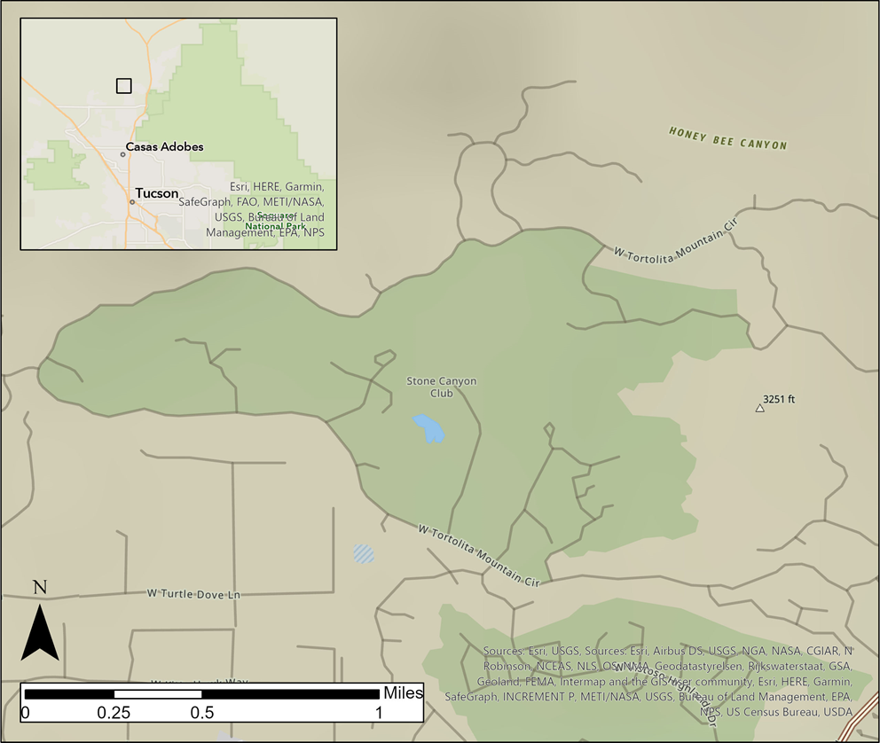
Study Site
Stone Canyon Club
North outskirts
of Tucson
Tortolita Mountain’s
foothills
Developing since
2000

Slide 4
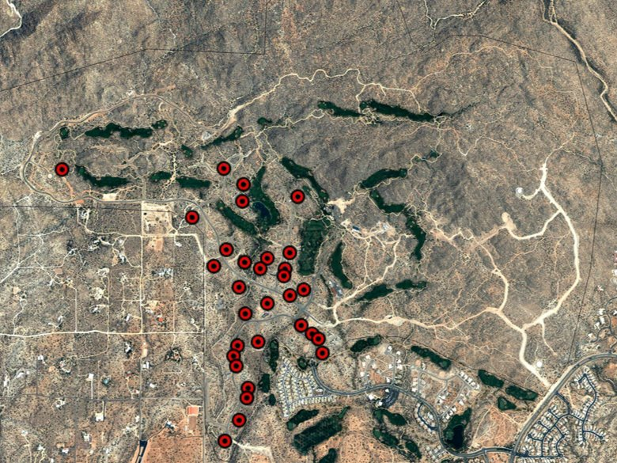
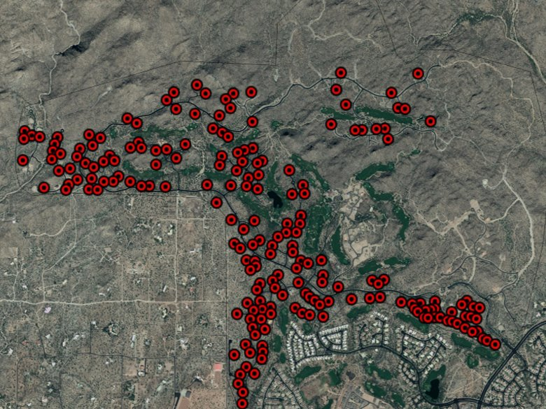
2003
(31 homes)
2019
(278 homes)

Slide 5
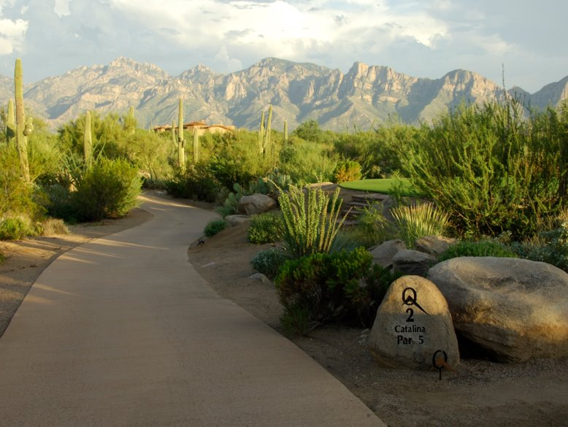
Study Site
Sparse Housing
Native Plants
Golf Course

Slide 6
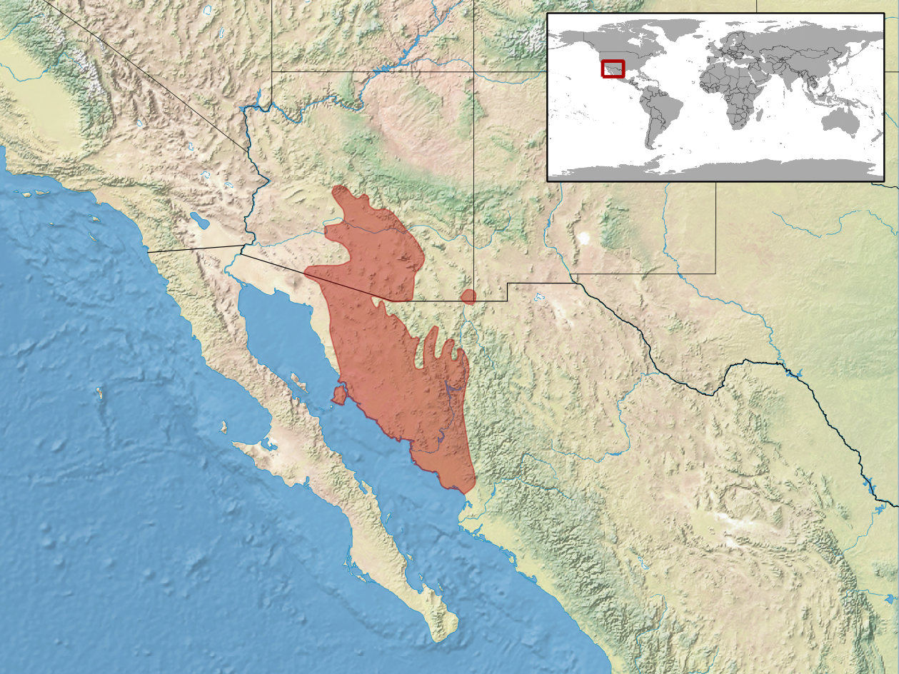
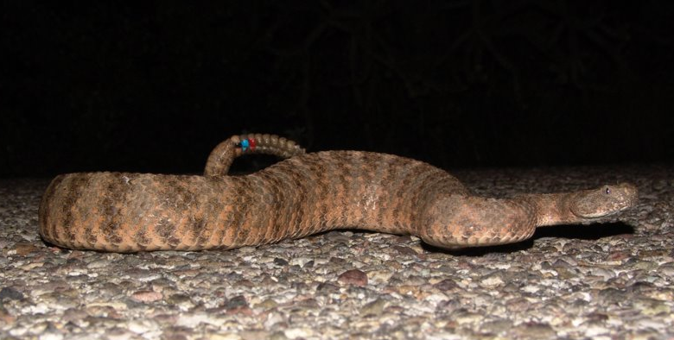
Study Subject: Tiger Rattlesnake (Crotalus tigris)
Distribution of tiger rattlesnakes
By rbrausse, CC BY-SA 3.0, https://commons.wikimedia.org/w/index.php?curid=24805187

Slide 7
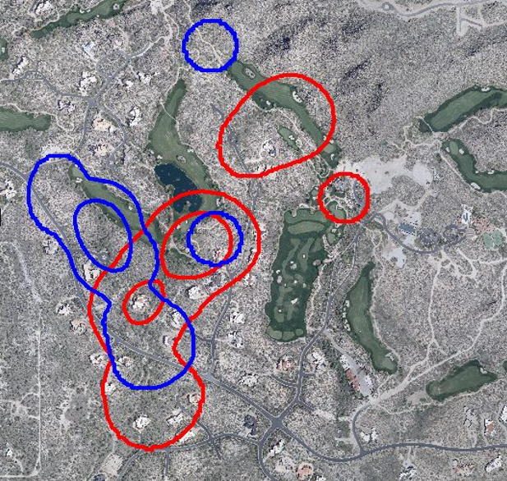
Project Goal
2005 2008
14 years of
radio-telemetry data
Changes in home ranges
in response to new houses
How do we find out what is
causing the changes in
the home ranges?
  land cover change
Home range of a male tiger rattlesnake

Slide 8
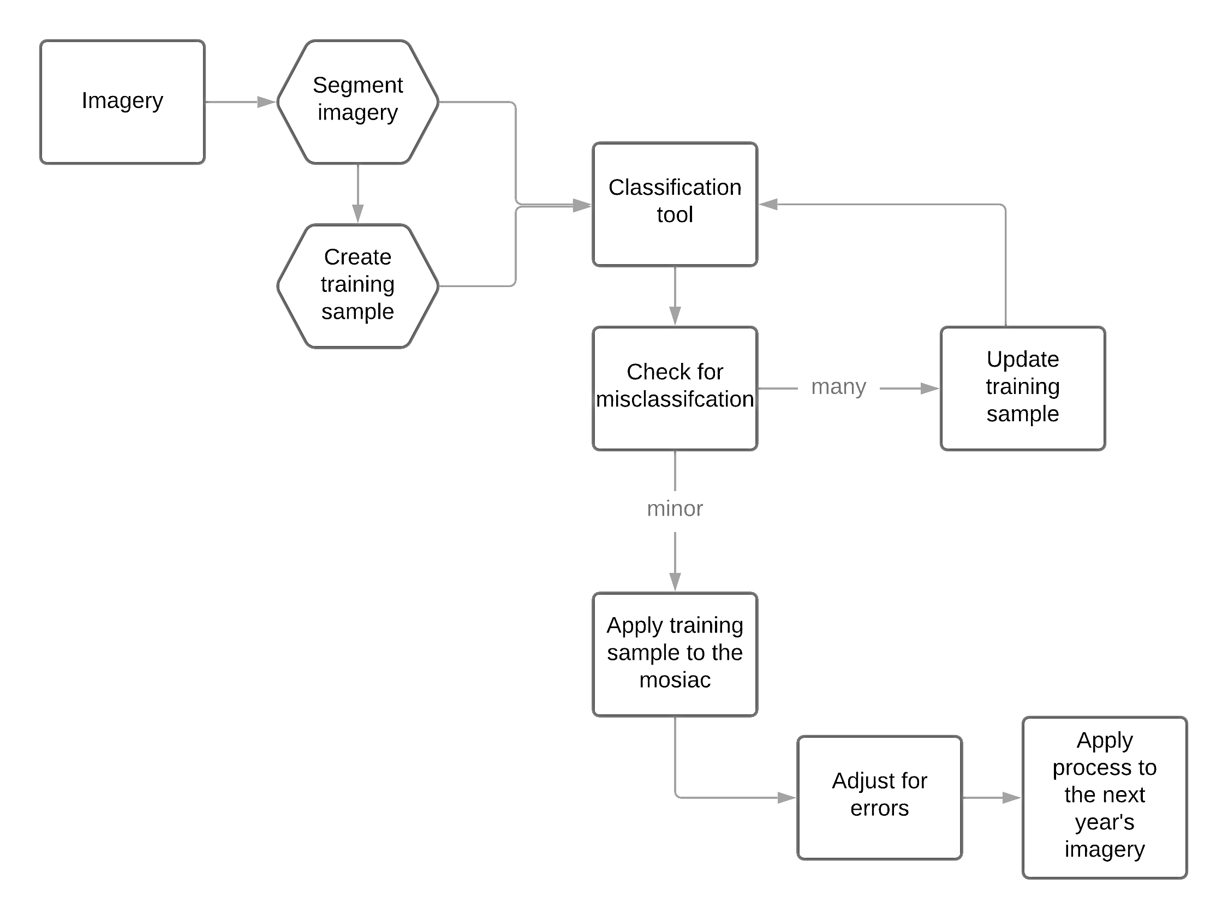
Methods
Notes:
Break into 2 slides
Flow chart
^{Image collection:}
^{orthographic imagery}
^{Pima Association of Government}
^{three-year increments}

Slide 9



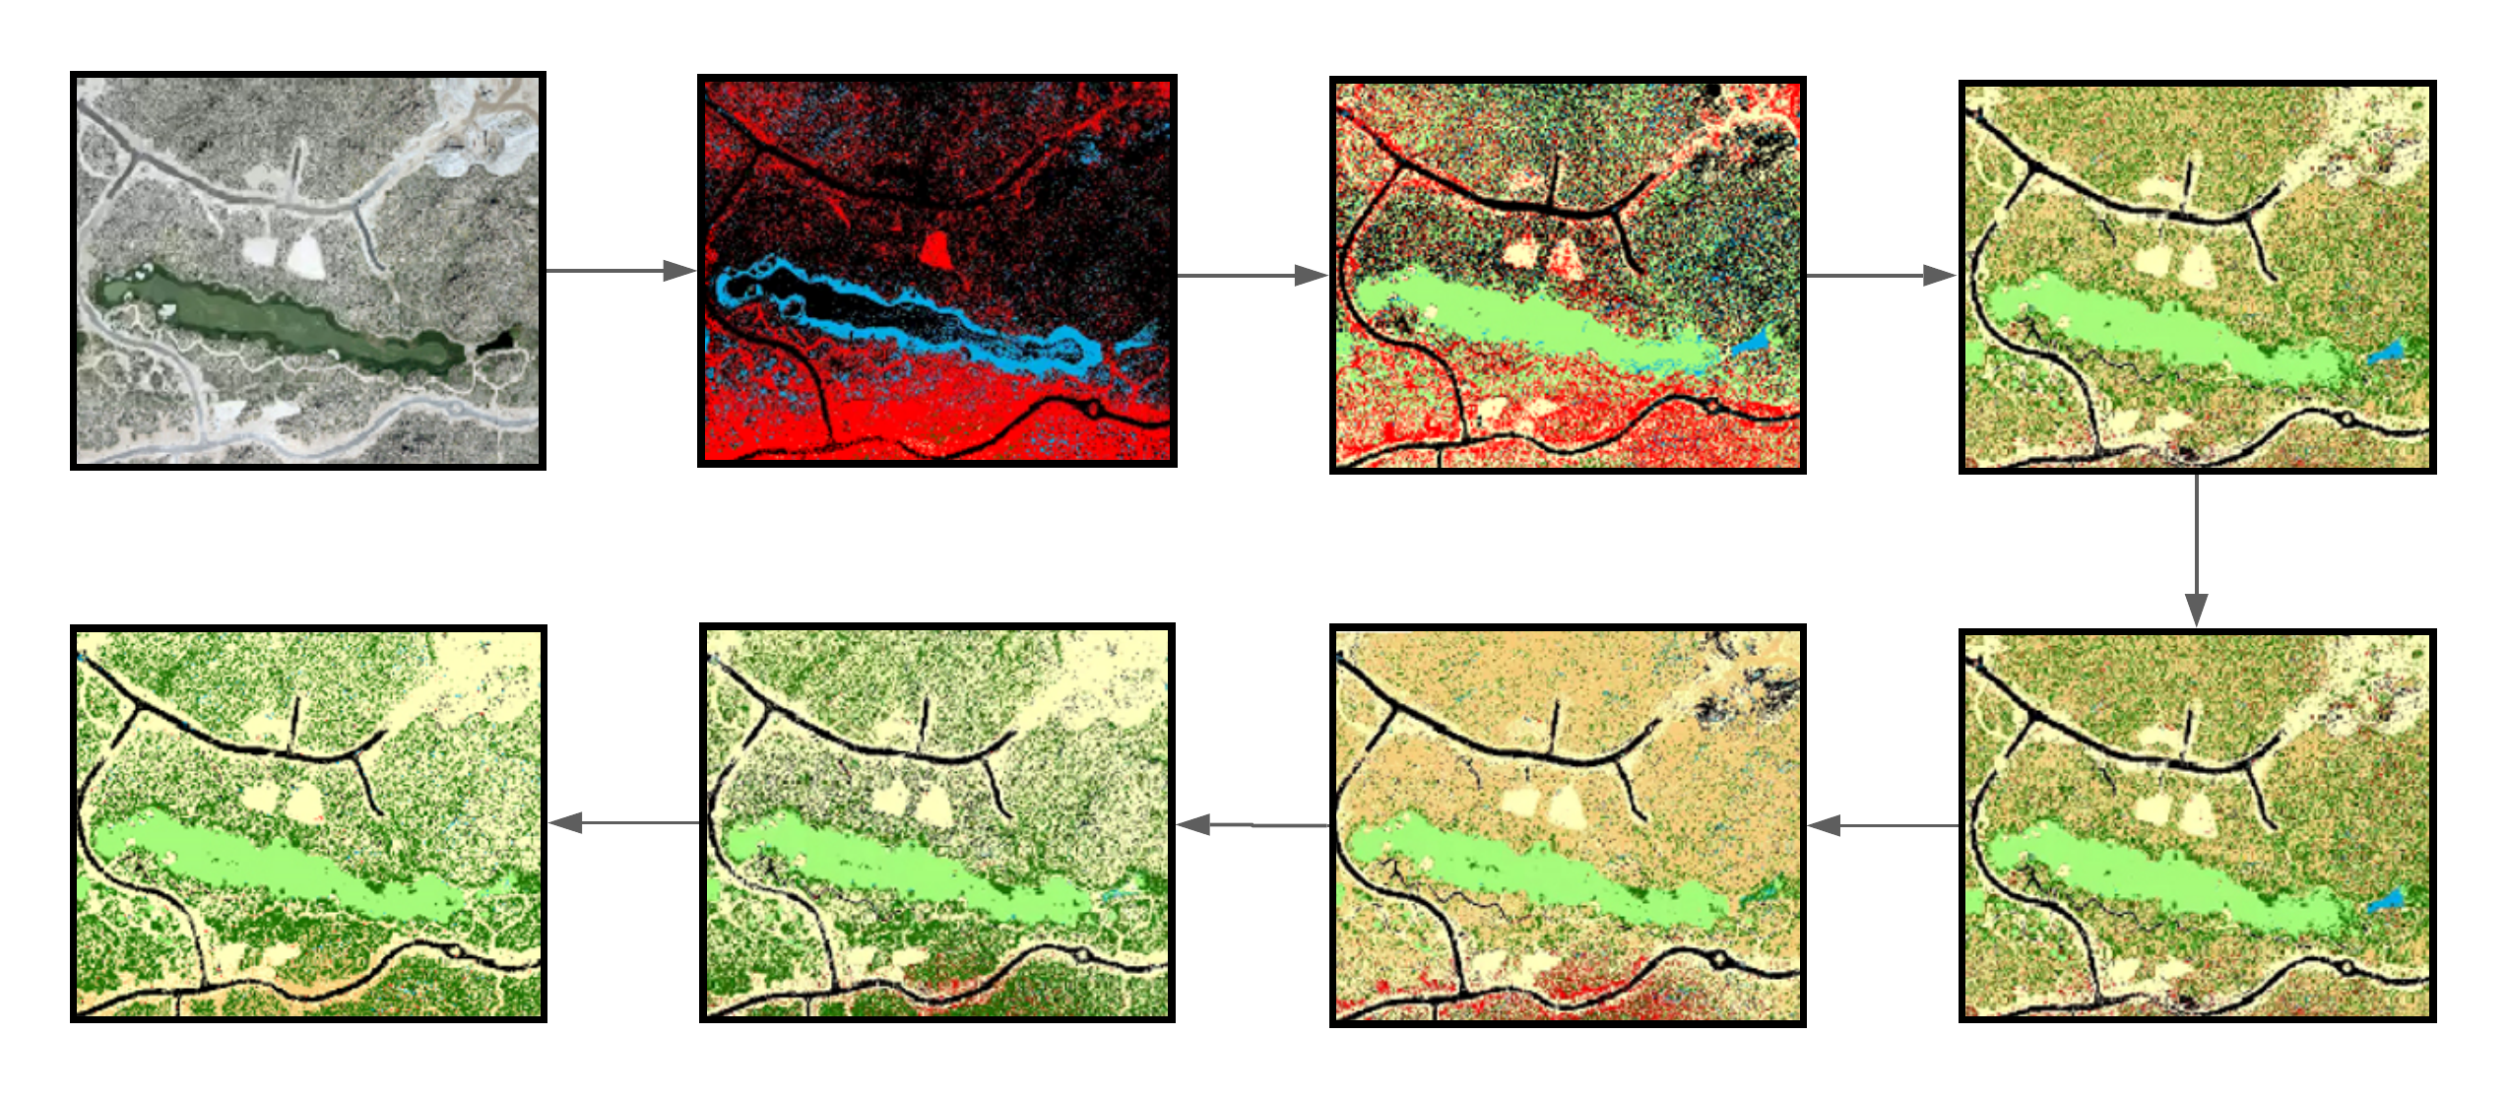
Methods
0
1
2
3
7
6
5
4

Slide 10
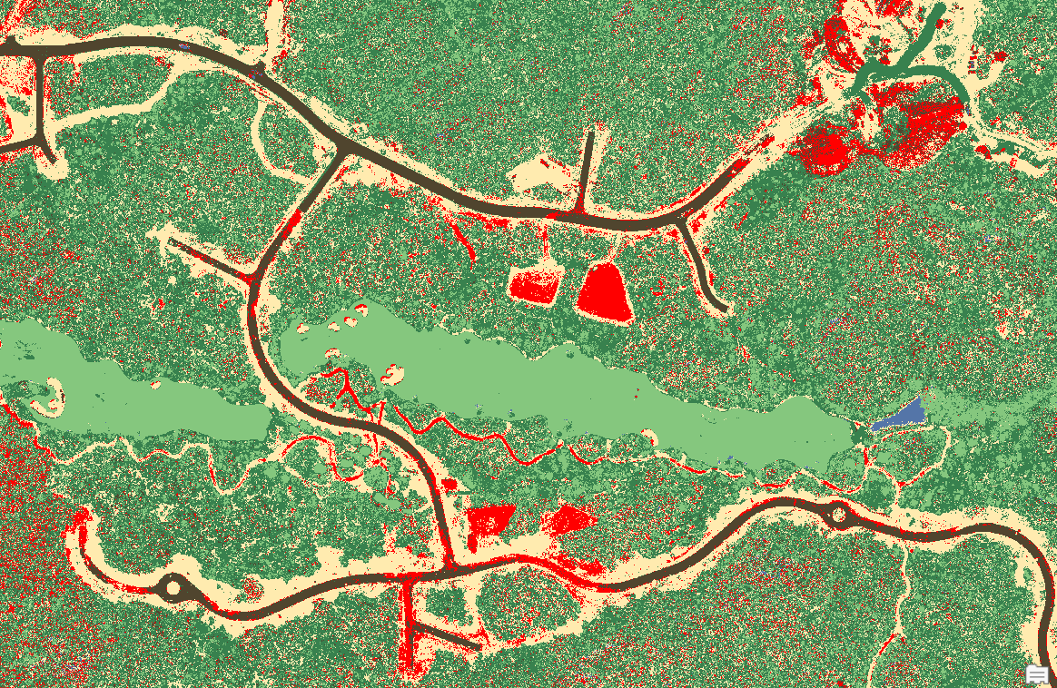
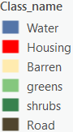
Result

Slide 11
Future directions
Identify key resource areas
  Compare change in home ranges with change in land cover
Apply process to other herpetofauna data
Provide insight into conservation efforts
Provide data for planning new urban developments
Notes:
Assume its good
Why it matters

Slide 12
Acknowledgements
Dr. Matt Goode
Dr. Brent Bibles
The Stone Canyon Club

Slide 13
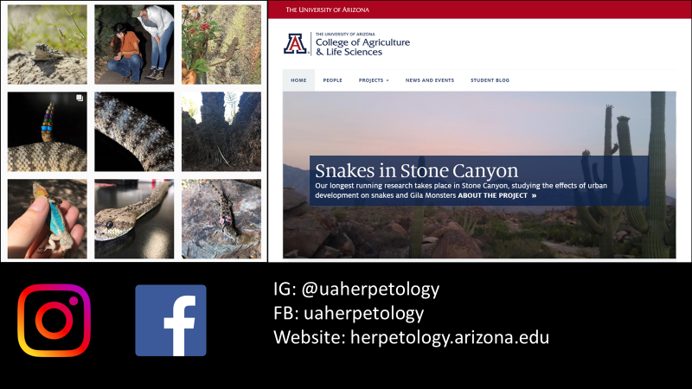

Slide 14
Thank you!

